Slide 1


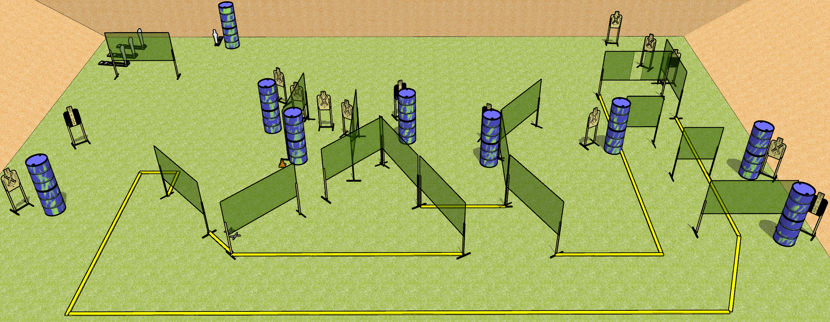
 | Dothan Gun Club – USPSA Match Go Big or Go Home Course Designer : Drew Coleman
START POSITION : Standing with both feet on X’s, wrists below belt
GUN READY CONDITION : Pistol loaded and holstered. PCC loaded, shouldered, safety on, pointed at orange cone. |  | SCORING: Comstock, 32 rounds TARGETS: 14 paper, 4 Steel SCORED HITS: Best 2 on paper, steel until down START-STOP: Audible, last shot RULES:
STAGE PROCEDURE: Engage targets as they become available from within the fault lines.

Slide 2
Go Big or Go Home
Written Stage Briefing
Go Big or Go Home is a 32 round, 160 point, Comstock Field Course. There are fourteen USPSA targets, three Colt poppers, and one mini popper. The best two hits on paper will score, and steel must fall to score. The start signal is audible.
Handgun start position is standing with both feet on X’s, wrists below belt. Handgun is loaded and holstered.
PCC start position is standing with both feet on X’s, muzzle aimed at orange cone. Carbine is loaded, safety on, held with both hands, shouldered.
Upon start signal, engage the targets as they become available from within the shooting area.

